Slide 1
Transaction Processing

Slide 2
Transaction Processing Systems
Transaction Processing Systems are the systems with large databases and hundreds of concurrent users executing database transactions.
For example airline reservations, banking, stock markets, etc.

Slide 3
Transaction
The transaction is a set of logically related operation. It contains a group of tasks.
A transaction is an action or series of actions. It is performed by a single user to perform operations for accessing the contents of the database.
A transaction is an executing program that forms a logical unit of database processing.
A transaction includes one or more database access operations- these can include insertion, deletion, modification, or retrieval operations.
Transaction is executed as a single unit. It is a program unit whose execution may or may not change the contents of a database.

Slide 4
Suppose an employee of bank transfers Rs 800 from X's account to Y's account. This small transaction contains several low-level tasks:
X's Account
Open_Account(X)
Old_Balance = X.balance
New_Balance = Old_Balance - 800
X.balance = New_Balance
Close_Account(X)

Slide 5
Y's Account
Open_Account(Y)
Old_Balance = Y.balance
New_Balance = Old_Balance + 800
Y.balance = New_Balance
Close_Account(Y)

Slide 6
Example
A transfer of money from one bank account to another requires two changes to the database both must succeed or fail together.
Subtracting the money from the savings account balance.
Adding the money to the checking account balance.

Slide 7
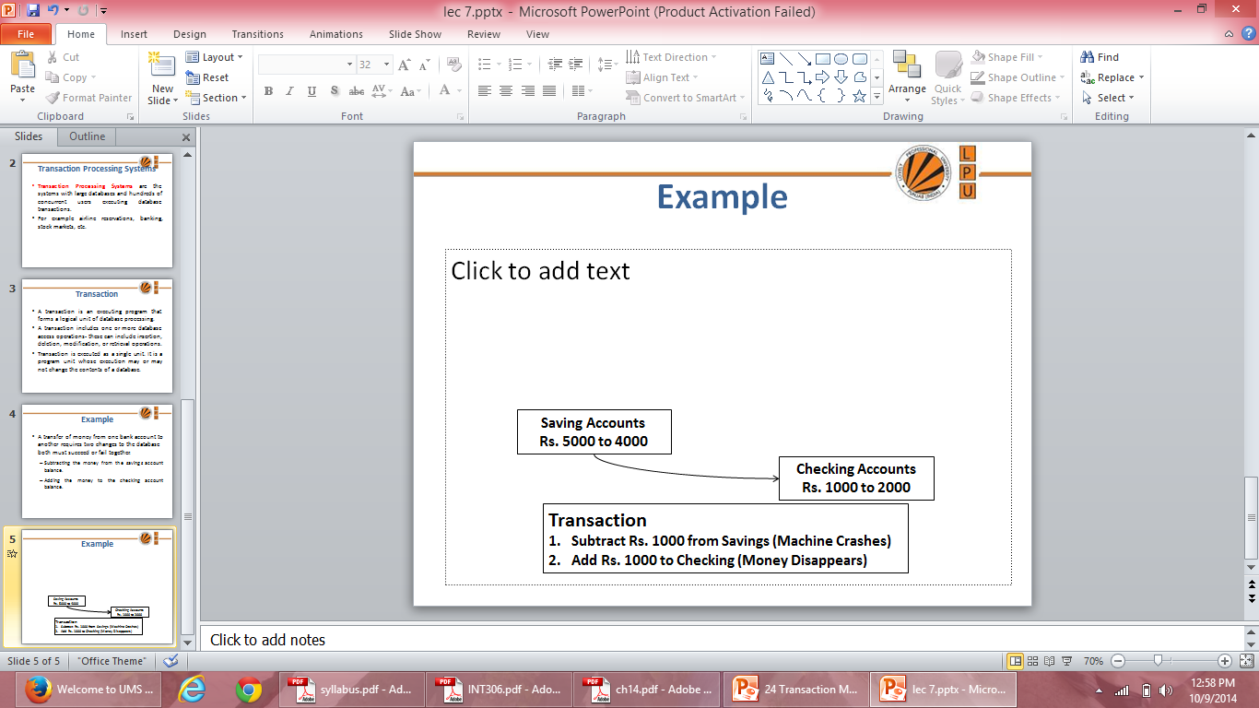
Example

Slide 8
Processes of Transaction
Read Operation: To read a database object, it is first brought into main memory from disk and then its value is copied into a program variable.
A
Read (2)
5000
INPUT (1)
5000 A
a
Physical Block (X)
5000
Program Variable
Main Memory (RAM)
Disk

Slide 9
Processes of Transaction
Write Operation: To write a database object, an in-memory copy of the object is first modified and then written back to disk.
A
Write (1)
5000 to 7000
OUTPUT (2)
5000 to 7000 A
a
Physical Block (X)
7000
Program Variable
Main Memory (RAM)
Disk

Slide 10
Desirable Properties of Transactions
ACID properties:
Atomicity: A transaction is an atomic unit of processing; it is either performed in its entirety or not performed at all.
Consistency preservation: A correct execution of the transaction must take the database from one consistent state to another.
Isolation: A transaction should appear as though it is being executed in isolation from other transactions, even if many transactions are executing concurrently. That is, the execution of a transaction should not be interfered with any other executing transactions.
Durability or permanency: Once a transaction changes the database and the changes are committed, these changes must never be lost because of any failure.

Slide 11
Atomicity
It states that all operations of the transaction take place at once if not, the transaction is aborted.
There is no midway, i.e., the transaction cannot occur partially. Each transaction is treated as one unit and either run to completion or is not executed at all.
Atomicity involves the following two operations:
Abort: If a transaction aborts then all the changes made are not visible.
Commit: If a transaction commits then all the changes made are visible.

Slide 12
Let's assume that following transaction T consisting of T1 and T2. A consists of Rs 600 and B consists of Rs 300. Transfer Rs 100 from account A to account B.
After completion of the transaction, A consists of Rs 500 and B consists of Rs 400.
T1 | T2
Read(A) A:= A-100 Write(A) | Read(B) Y:= Y+100 Write(B)

Slide 13
If the transaction T fails after the completion of transaction T1 but before completion of transaction T2, then the amount will be deducted from A but not added to B. This shows the inconsistent database state. In order to ensure correctness of database state, the transaction must be executed in entirety.

Slide 14
Consistency
The integrity constraints are maintained so that the database is consistent before and after the transaction.
The execution of a transaction will leave a database in either its prior stable state or a new stable state.
The consistent property of database states that every transaction sees a consistent database instance.
The transaction is used to transform the database from one consistent state to another consistent state.

Slide 15
For example: The total amount must be maintained before or after the transaction.
Total before T occurs = 600+300=900
Total after T occurs= 500+400=900
Therefore, the database is consistent. In the case when T1 is completed but T2 fails, then inconsistency will occur.

Slide 16
Isolation
It shows that the data which is used at the time of execution of a transaction cannot be used by the second transaction until the first one is completed.
In isolation, if the transaction T1 is being executed and using the data item X, then that data item can't be accessed by any other transaction T2 until the transaction T1 ends.
The concurrency control subsystem of the DBMS enforced the isolation property.

Slide 17
Lets suppose that T1 and T2 perform concurrently, their schedule is shown below:
T1 | T2 | Status
Read (A, a) |  | Value of A i.e. 1000 is copied to local variable a
a: a-50 |  | Local variable a = 950
Write (A, a) |  | Value of local variable a 950 is copied to database item A
 | Read (A, a) | Value of database item A 950 is copied to a
 | Read (B, b) | Value of database item B 2000 is copied to b
 | Display (a+b) | 2950 is displayed as sum of accounts A and B
Read (B, b) |  | Value of data item B 2000 is copied to local variable b
b: = b+50 |  | Local variable b = 2050
Write (B, b) |  | Value of local variable b 2050 is copied to database item B

Slide 18
Durability
The durability property is used to indicate the performance of the database's consistent state. It states that the transaction made the permanent changes.
They cannot be lost by the erroneous operation of a faulty transaction or by the system failure. When a transaction is completed, then the database reaches a state known as the consistent state. That consistent state cannot be lost, even in the event of a system's failure.
The recovery subsystem of the DBMS has the responsibility of Durability property.

Slide 19
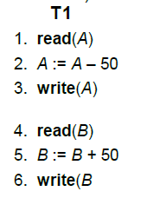
Transaction Properties
Let T1 be a transaction that transfers Rs 50 from account A to account B. This transaction can be defined as:
Say value of A prior to transaction was 1000 and that of B was 2000

Slide 20
Atomicity: Suppose that during the execution of T1, a power failure has occurred that prevented the T1 to complete successfully. The point of failure may be after the completion of Write(A) and before Write(B). It means that the changes in A are performed but not in B. Thus the values of account A and B are Rs.950 and Rs.2000 respectively. We have lost Rs.50 as a result of this failure.
Now, our database is in inconsistent state.
The reason for this inconsistent state is that our transaction is completed partially.
In order to maintain atomicity of transaction, the database system keeps track of the old values of any write and if the transaction does not complete its execution, the old values are restored to make it appear as the transaction never executed.

Slide 21
Consistency: The consistency requirement here is that the sum of A and B must be unchanged by the execution of the transaction. It can be verified easily that, if the database is consistent before an execution of the transaction, the database remains consistent after the execution of the transaction.
Ensuring consistency for an individual transaction is the responsibility of the application programmer who codes the transaction.

Slide 22
Isolation: If several transactions are executed concurrently (or in parallel), then each transaction must behave as if it was executed in isolation. It means that concurrent execution does not result an inconsistent state.
For example, consider another transaction T2, which has to display the sum of account A and B. Then, its result should be Rs.3000.

Slide 23
Transaction Properties
Lets suppose that T1 and T2 perform concurrently, their schedule is shown below:
T1 | T2 | Status
Read (A, a) |  | Value of A i.e. 1000 is copied to local variable a
a: a-50 |  | Local variable a = 950
Write (A, a) |  | Value of local variable a 950 is copied to database item A
 | Read (A, a) | Value of database item A 950 is copied to a
 | Read (B, b) | Value of database item B 2000 is copied to b
 | Display (a+b) | 2950 is displayed as sum of accounts A and B
Read (B, b) |  | Value of data item B 2000 is copied to local variable b
b: = b+50 |  | Local variable b = 2050
Write (B, b) |  | Value of local variable b 2050 is copied to database item B

Slide 24
Durability: Once the execution of the transaction completes successfully, and the user who initiated the transaction has been notified that the transfer of funds has taken place, it must be the case that no system failure will result in a loss of data corresponding to this transfer of funds.

Slide 25
Transaction States
Active state– the initial state; the transaction stays in this state while it is executing .
Partially committed state– after the final statement has been executed.
Failed state -- after the discovery that normal execution can no longer proceed.
Aborted state– after the transaction has been rolled back and the database restored to its state prior to the start of the transaction. Two options after it has been aborted:
restart the transaction can be done only if no internal logical error
kill the transaction
Committed state – after successful completion

Slide 26
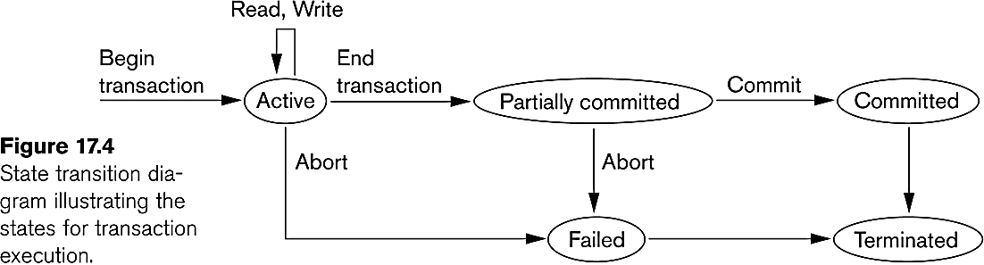
State Transition Diagram

Slide 27
Active state
The active state is the first state of every transaction. In this state, the transaction is being executed.
For example: Insertion or deletion or updating a record is done here. But all the records are still not saved to the database.

Slide 28
Partially committed state
In the partially committed state, a transaction executes its final operation, but the data is still not saved to the database.
In the total mark calculation example, a final display of the total marks step is executed in this state.

Slide 29
Failed state
If any of the checks made by the database recovery system fails, then the transaction is said to be in the failed state.
In the example of total mark calculation, if the database is not able to fire a query to fetch the marks, then the transaction will fail to execute.

Slide 30
Aborted state
If any of the checks fail and the transaction has reached a failed state then the database recovery system will make sure that the database is in its previous consistent state. If not then it will abort or roll back the transaction to bring the database into a consistent state.
If the transaction fails in the middle of the transaction then before executing the transaction, all the executed transactions are rolled back to its consistent state.
After aborting the transaction, the database recovery module will select one of the two operations:
Re-start the transaction
Kill the transaction

Slide 31
Committed state
A transaction is said to be in a committed state if it executes all its operations successfully. In this state, all the effects are now permanently saved on the database system.

Slide 32
Schedule
A series of operation from one transaction to another transaction is known as schedule.
It is used to preserve the order of the operation in each of the individual transaction.

Slide 33
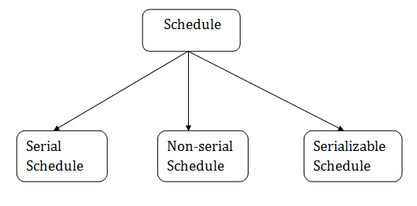

Slide 34
Serial Schedule
The serial schedule is a type of schedule where one transaction is executed completely before starting another transaction. In the serial schedule, when the first transaction completes its cycle, then the next transaction is executed.
For example: Suppose there are two transactions T1 and T2 which have some operations. If it has no interleaving of operations, then there are the following two possible outcomes:

Slide 35
Execute all the operations of T1 which was followed by all the operations of T2.
Execute all the operations of T2 which was followed by all the operations of T1.
In the given (a) figure, Schedule A shows the serial schedule where T1 followed by T2.
In the given (b) figure, Schedule B shows the serial schedule where T2 followed by T1.

Slide 36
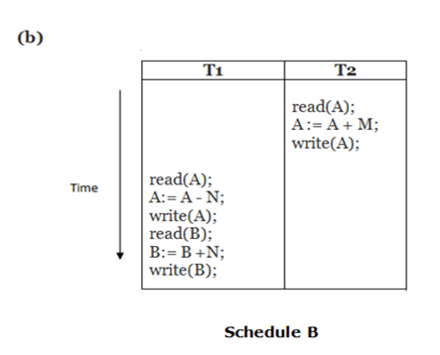
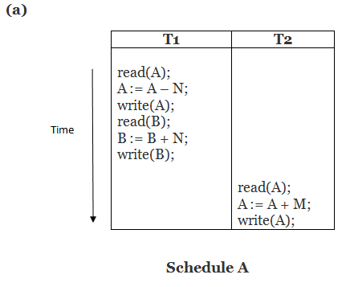

Slide 37
Non Serial Schedule
If interleaving of operations is allowed, then there will be non-serial schedule.
It contains many possible orders in which the system can execute the individual operations of the transactions.
In the given figure (c) and (d), Schedule C and Schedule D are the non-serial schedules. It has interleaving of operations.

Slide 38
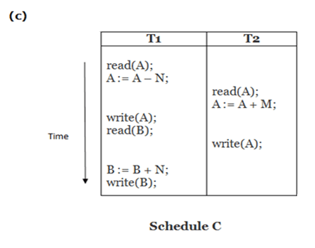
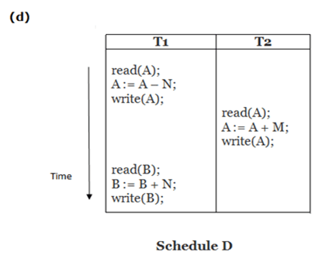

Slide 39
Interleaving
An interleaved schedule is a schedule in which the operations of an individual transaction are executed in order with respect to the same transaction, but without the restriction that the transactions be scheduled as a whole.

Slide 40
Serializable Schedule
A schedule is serialized if it is equivalent to a serial schedule. A concurrent schedule must ensure it is the same as if executed serially means one after another. It refers to the sequence of actions such as read, write, abort, commit are performed in a serial manner.

Slide 41
Schedules
Schedule – a sequences of instructions that specify the chronological order in which instructions of concurrent transactions are executed
a schedule for a set of transactions must consist of all instructions of those transactions
must preserve the order in which the instructions appear in each individual transaction.
A transaction that successfully completes its execution will have a commit instructions as the last statement
by default transaction assumed to execute commit instruction as its last step
A transaction that fails to successfully complete its execution will have an abort instruction as the last statement

Slide 42
Scheduling of Transactions
Serial Schedule: Each serial schedule consists of a sequence of instructions from various transactions, where the instructions belonging to one single transaction appear together in that schedule. If the actions of different transactions are not interleaved, we call that schedule a serial schedule.

Slide 43
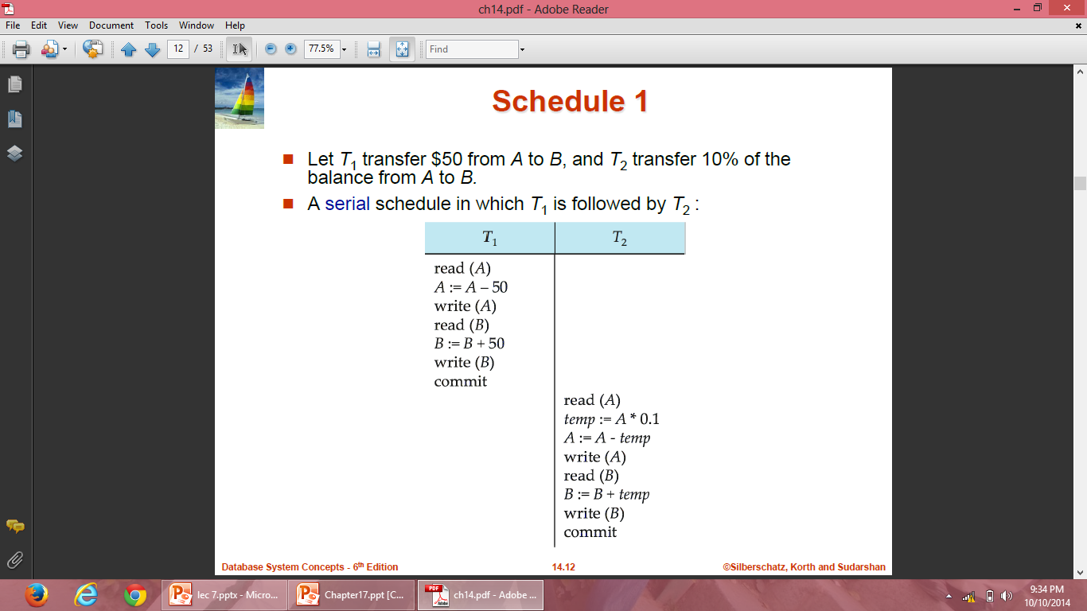
Schedule 1

Slide 44
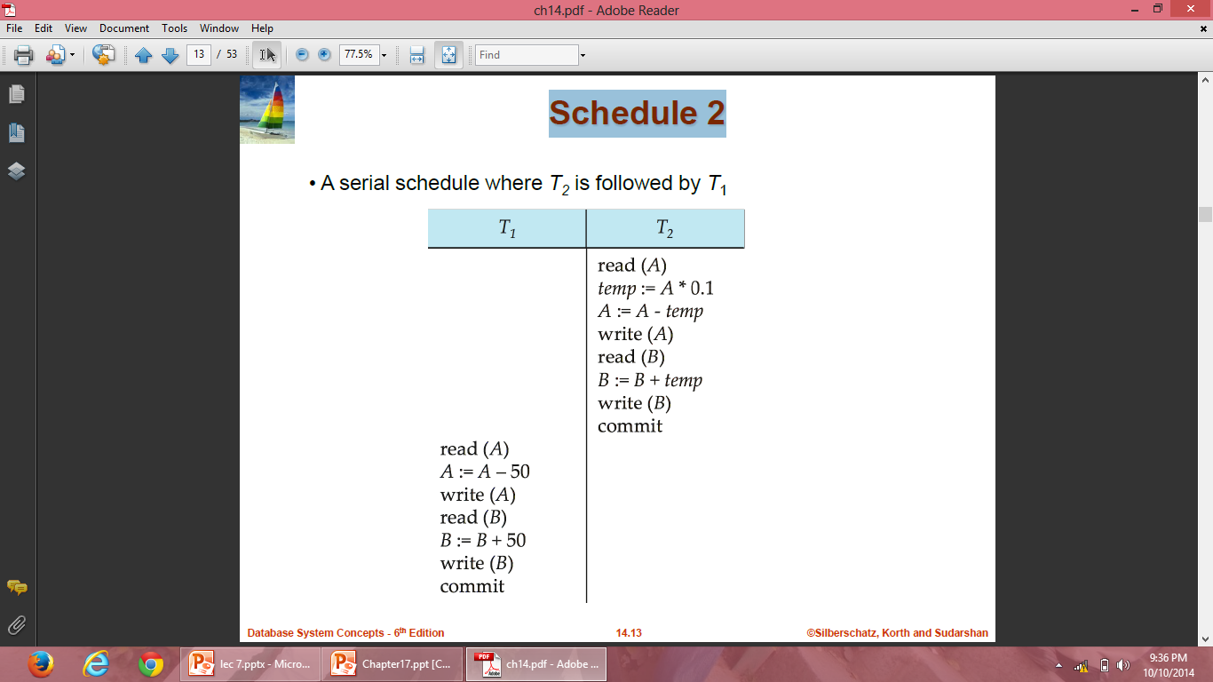
Schedule 2

Slide 45
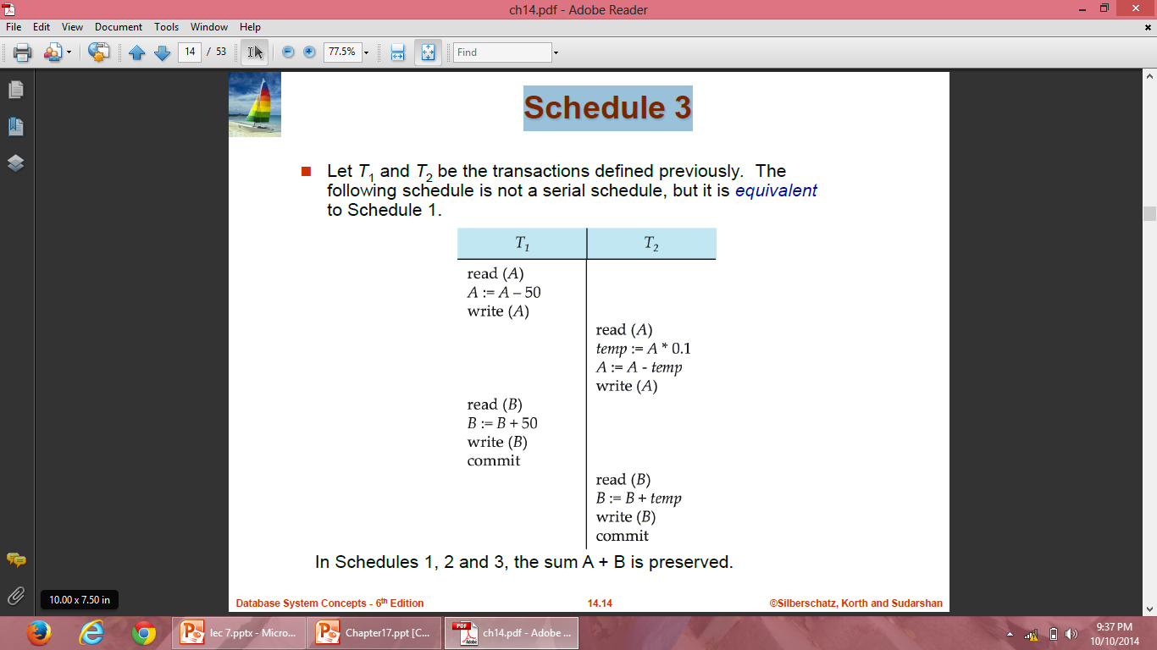
Schedule 3

Slide 46
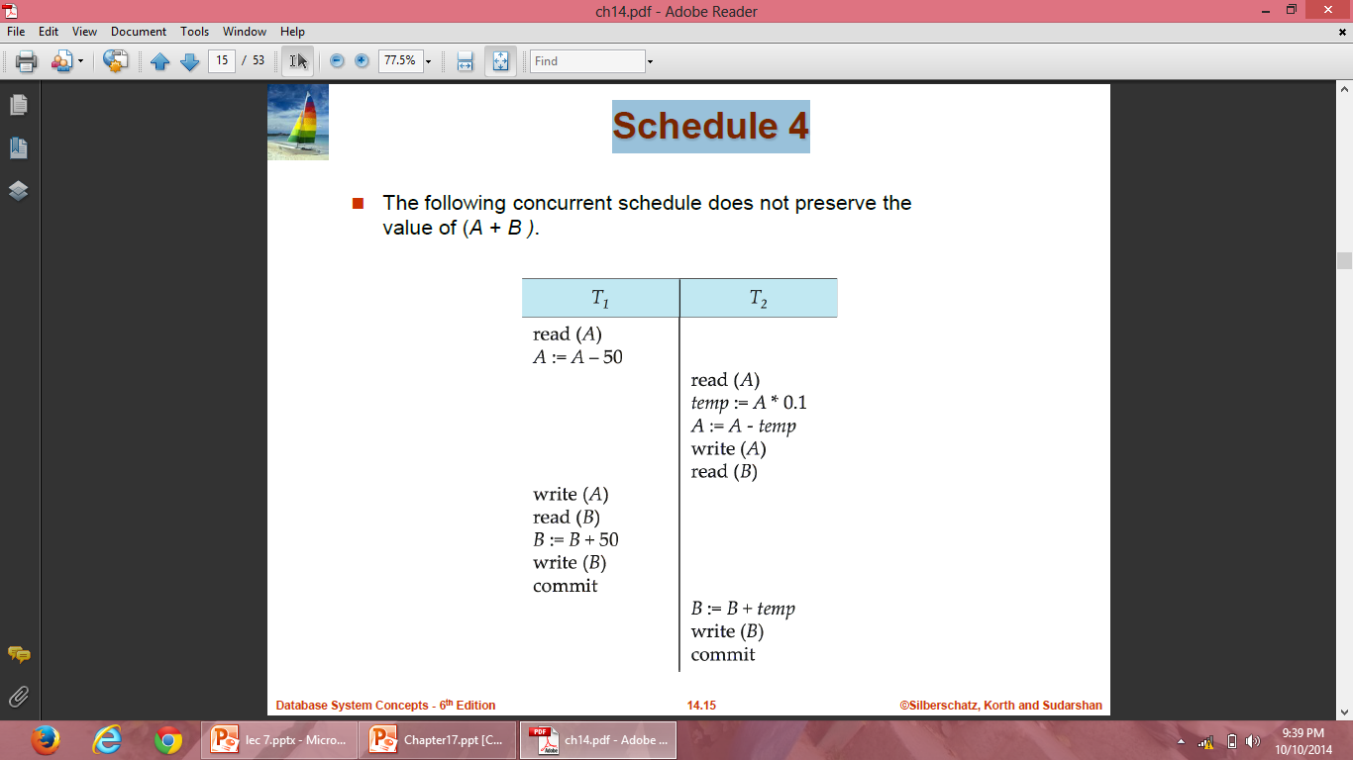
Schedule 4

Slide 47
Scheduling of Transactions
Serializiable Schedule: A non-serial schedule that is equivalent to some serial execution of transactions is called a serializiable schedule.
For example schedule-3 is serializable schedule, which is equivalent to schedule-1 and schedule-2.
The objective of serializability is to find non-serial schedules that allow transactions to execute concurrently without interfering with one another, and thereby produce a database state that could be produced by a serial execution.

Slide 48
Serializability
Basic Assumption – Each transaction preserves database consistency.
Thus serial execution of a set of transactions preserves database consistency.
A (possibly concurrent) schedule is serializable if it is equivalent to a serial schedule. Different forms of schedule equivalence give rise to the notions of:
1. conflict serializability
2. view serializability

Slide 49
Conflict Serializability
If a schedule S can be transformed into a schedule S’ by a series of swaps of non-conflicting instructions, we say that S and S’ are conflict equivalent.
We say that a schedule S is conflict serializable if it is conflict equivalent to a serial schedule.

Slide 50
Conflict Serializability
We need to check the conflicts between two consecutive operations of two different transactions in a schedule. Operations upon data can be read or write. There are two possibilities:
If two consecutive operations are on different data items, then they do not conflict i.e. their order of execution does not matter and we can swap them without affecting their result.
If two consecutive operations are on same data items, then they can conflict i.e their order of execution matters and we cannot swap them.

Slide 51
R(A) R(A)- Non Conflict Pairs
R(A) W(A)- Conflict Pairs
W(A) R(A)
W(A) W(A)
R(B) R(A)- Non Conflict Pairs
W(B) R(A)
R(B) W(A)
W(A) WB)

Slide 52
Conflict Serializability
Consider a schedule S in which there are two consecutive operations Oi and Oj of two transactions Ti and Tj and both operations refer to the same data item A. Then, there are following four cases:
Oi= read(A) and Oj= read(A). Then, their order does not matter because same value of A is read by Ti and Tj.
Oi= read(A) and Oj= write(A). Then, their order matters. If Oi comes before Oj then, Oj does not read the value of A written by Oi. If Oj comes before Oi then, Oi reads the value of A that is written by Oj.
Oi= write(A) and Oj= read(A). Then, their order matters. If Oi comes before Oj then, Oj reads the value of A written by Oi. If Oj comes before Oi then, Oj does not read the value of A that is written by Oi.
Oi= write(A) and Oj= write(A). Then, their order matters. If Oi comes after Oj then, the value of A written by Oi is stored in database. If Oj comes after Oi then, the value of A written by Oj is stored in database.

Slide 53
S1
S2
T1 | T2
R(A)
W(A)
 | R(A)
 | W(A)
R(B)
T1 | T2
R(A)
W(A)
R(B)
 | R(A)
 | W(A)

Slide 54
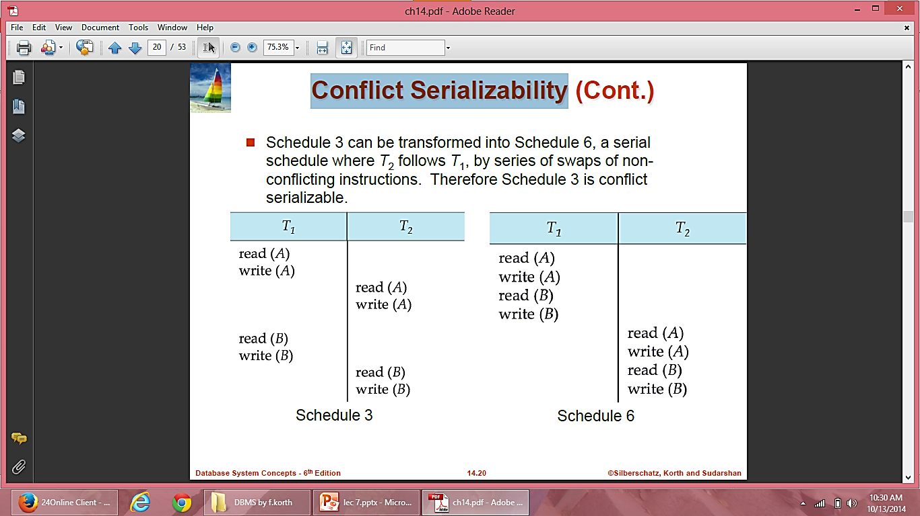
Conflict Serializability

Slide 55
Precedence Graph of Conflict Serializability
T1 | T2 | T3
R(X)
 |  | R(Y)
 |  | R(X)
 | R(y)
 | R(Z)
 |  | W(Y)
 | W(Z)
R(Z)
W(X)
W(Z)
Check conflict pairs in other transactions and draw the edges

Slide 56
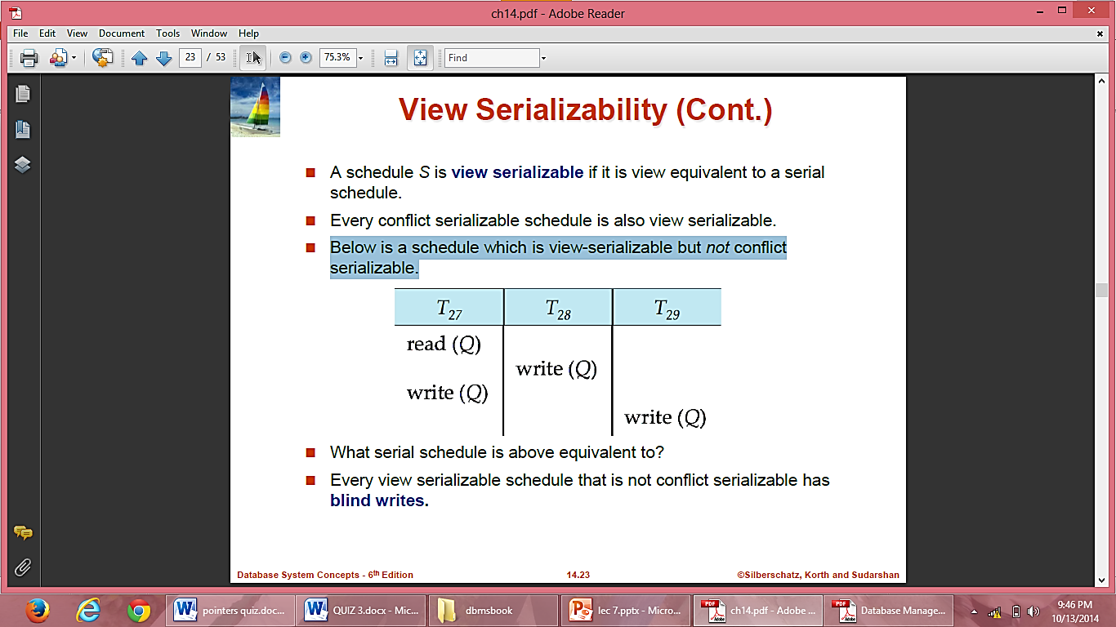
View Serializability
A schedule is said to be view-serializable if it is view-equivalent to some serial schedule.
Any schedule that is conflict-serializable is also view-serializable, but not vice versa.
Below is a schedule which is view-serializable but not conflict serializable.
Every view serializable schedule that is not conflict serializable has blind writes.

Slide 57
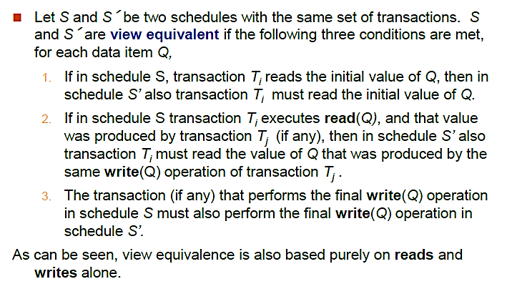
View Serializability

Slide 58
Initial read-An initial read of both schedule is same.
Updated read- In Schedule S1 if Ti is reading A which is updated by Tj then in S2 also.
Final write – Final write must be same between both the schedule.

Slide 59
Initial read-An initial read of both schedule is same.
Schedule 1:
Schedule 1:
T1 | T2
R(A)
 | W(A)
Schedule 2:
T1 | T2 | T3
 | W(A)
R(A)

Slide 60
Updated read- In Schedule S1 if Ti is reading A which is updated by Tj then in S2 also.
Schedule 1:
Schedule 1:
T1 | T2 | T3
W(A)
 | W(A)
 |  | R(A)
Schedule 2:
T1 | T2 | T3
W(A)
 | W(A)
 |  | R(A)

Slide 61
Updated read- In Schedule S1 if Ti is reading A which is updated by Tj then in S2 also.
Schedule 1:
Schedule 1:
T1 | T2 | T3
W(A)
 | W(A)
 |  | R(A)
Schedule 2:
T1 | T2 | T3
W(A)
 |  | R(A)
 | W(A)
Schedule 1 and schedule 2 are not view equivalent

Slide 62
Final write – Final write must be same between both the schedule.
Schedule 1:
Schedule 1:
T1 | T2 | T3
W(A)
 | R(A)
 |  | W(A)
Schedule 2:
T1 | T2 | T3
 | R(A)
W(A)
 |  | W(A)

Slide 63
Example
Schedule 3:
T1 | T2
R(A)
 | W(A)
W(A)
Schedule 4:
T1 | T2
R(A)
W(A)
 | W(A)
Schedule 3 and schedule 4 are not view equivalent

Slide 64
Schedule 5: View equivalent
T1 | T2
R(X)
W(X)
 | R(X)
 | W(X)
R(Y)
W(Y)
 | R(Y)
 | W(Y)
T1 | T2
R(X)
W(X)
R(Y)
W(Y)
 | R(X)
 | W(X)
 | R(Y)
 | W(Y)

Slide 65
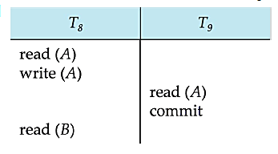
Recoverable Schedules
Need to address the effect of transaction failures on concurrently running transactions.
Recoverable schedule — if a transaction Tj reads a data item previously written by a transaction Ti , then the commit operation of Ti appears before the commit operation of Tj.
The following schedule is not recoverable if T9 commits immediately after the read
If T8 should abort, T9 would have read an inconsistent database state. Hence, database must ensure that schedules are recoverable.

Slide 66
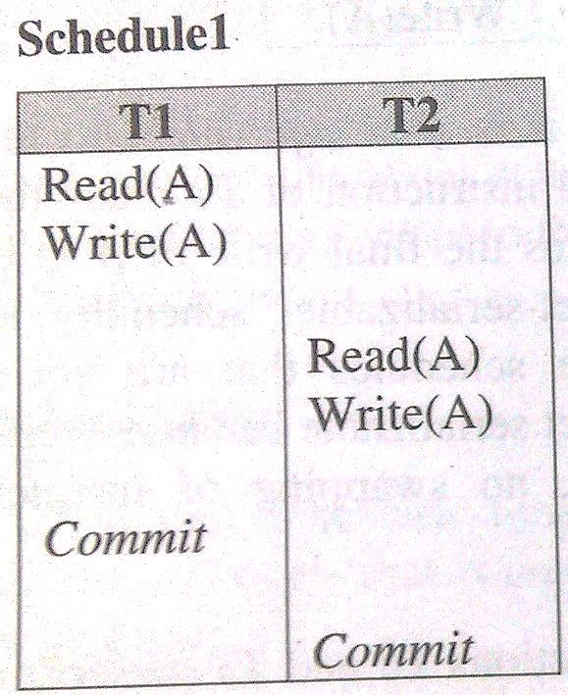
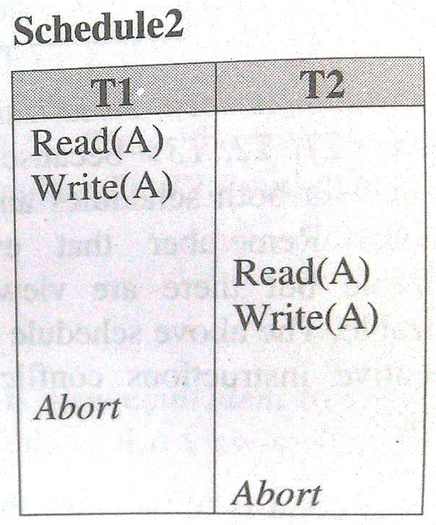
Recoverable Schedules
A schedule is said to be recoverable, if for each pair of transaction Ti and Tj such that Tj reads a data item previously written by Ti, the commit operation of Ti appears before the commit operation of Tj.
Both the above schedules are recoverable .

Slide 67
Recoverable Schedules
Schedule1 is recoverable because T2 reads the value of A updated by T1 and also T1 commits before T2 which makes the value read by T2 correct. Then T2 can commit itself.
In schedule2, if T1 is aborted, T2 has to abort because the value A it read is incorrect.
In both cases, the database is in consistent state.

Slide 68
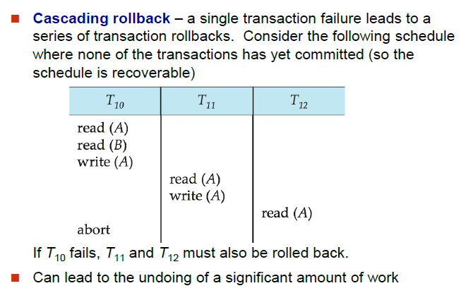
Cascading Rollbacks

Slide 69
If in a schedule, failure of one transaction causes several other dependent transactions to rollback or abort, then schedule is called as cascading schedule or cascading rollback or cascading abort.
It leads to the wastage of CPU time.
Cascading rollbacks occur because of Dirty read problems.

Slide 70
Cascadeless Schedules
Cascadeless schedules—cascading rollbacks cannot occur; for each pair of transactions Ti and Tj such that Tj reads a data item previously written by Ti, the commit operation of Ti appears before the read operation of Tj.
Every cascadeless schedule is also recoverable

